Slide 1

Combating Replay Attacks Against Voice Assistants
Swadhin Pradhan, Wei Sun, Ghufran Baig, Lili Qiu
UbiComp 2019

Slide 2
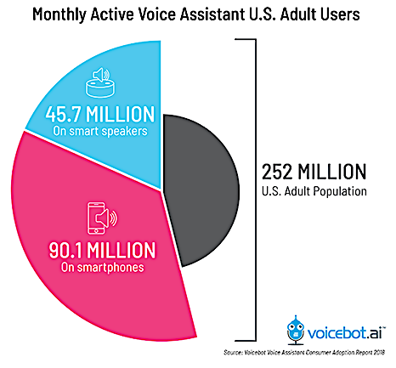
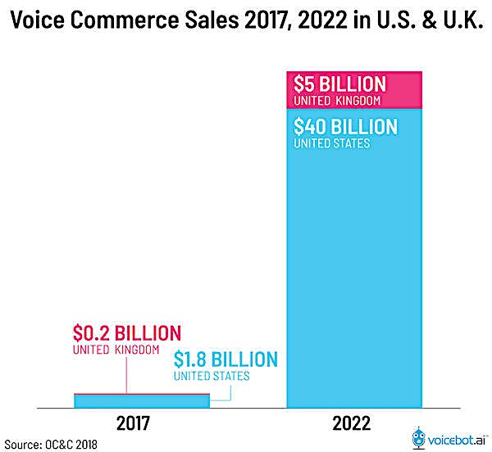
Voice is a popular interface

Slide 3
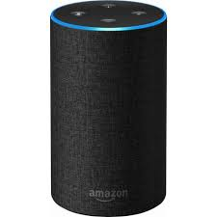
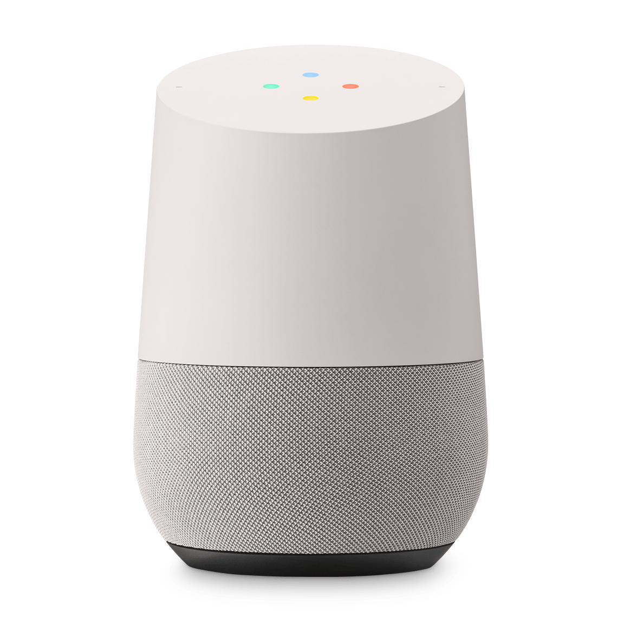
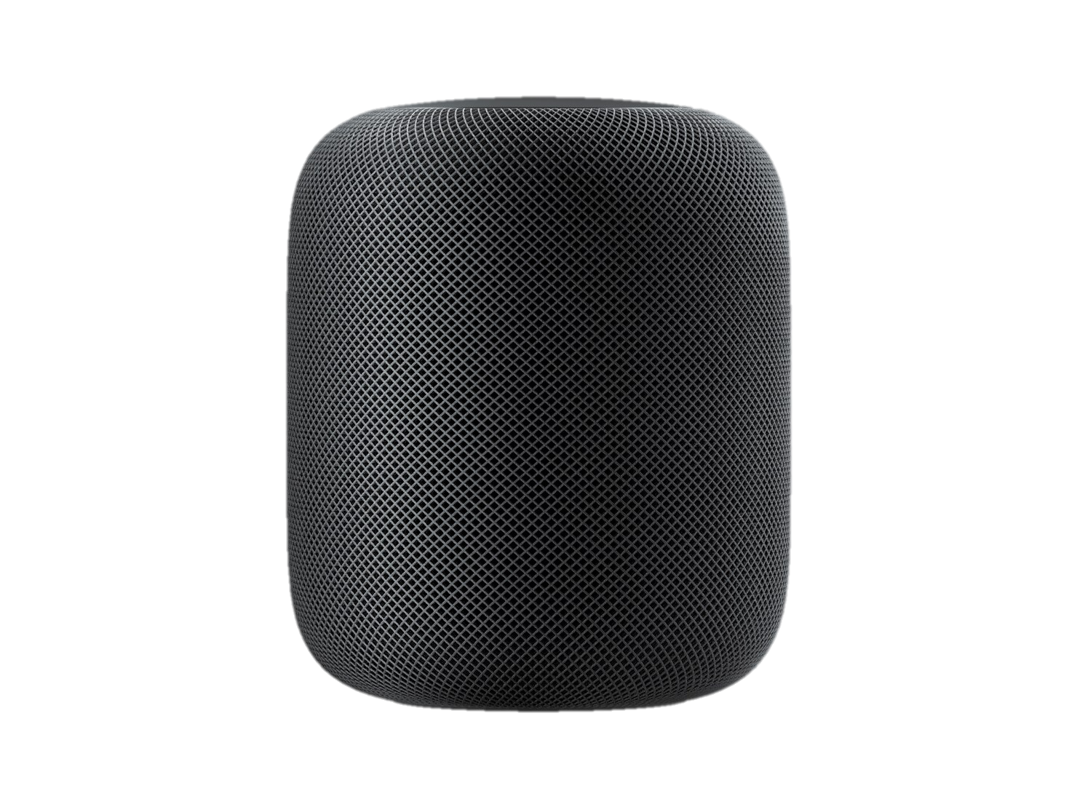
Voice assistants are ubiquitous
Amazon Echo
Google Home
Apple Homepod

Slide 4
Voice is an open channel
with different attack modalities …
Inaudible voice attack
[Roy et al. , MobiSys ‘17]
Human-based voice impersonation attack
[ Johnson et al., BATS ‘13]
Mangled voice attack
[Vaidya et al., WOOT ‘15]

Slide 5
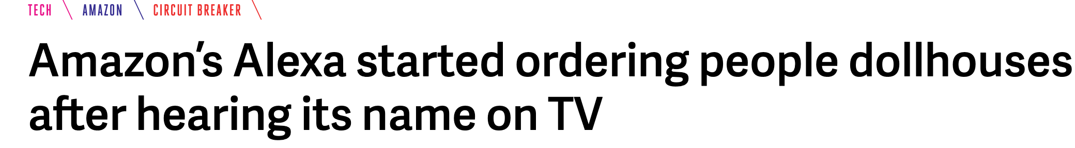


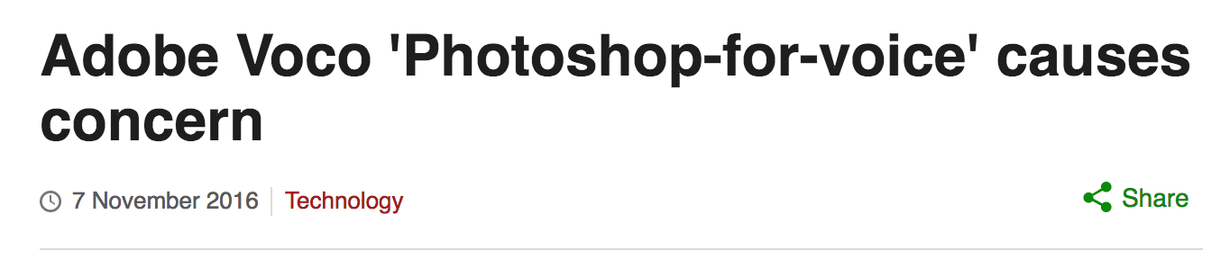
Voice is an open channel
with different attack modalities …
Voice replay attack

Slide 6
Our threat model of replay attack
An attacker can collect voice samples or synthesize the voice commands
Remote Voice Replay
Attacker has access to a speaker inside home and can remotely replay
Local Voice Replay
Attacker is physically close to the smart speaker and can replay
Sophisticated Voice Replay
Attacker not only replays but also manipulates his physiological signals

Slide 7
Goal
Design a long range device-free voice replay detection system

Slide 8
Three key observations
Live voice has different spectral characteristics in both frequency and phase domain
Breathing pattern changes distinctly during speech
Breathing patterns during speech are distinct across users

Slide 9
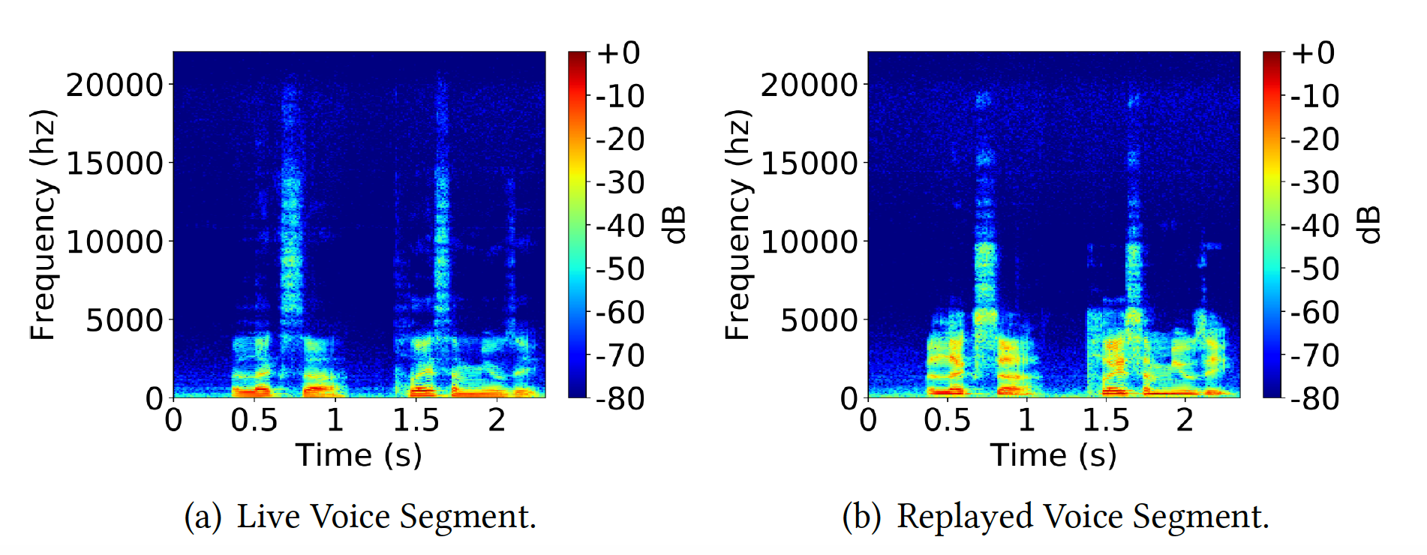
Different characteristics of live voice
More Energy in higher frequency bands

Slide 10
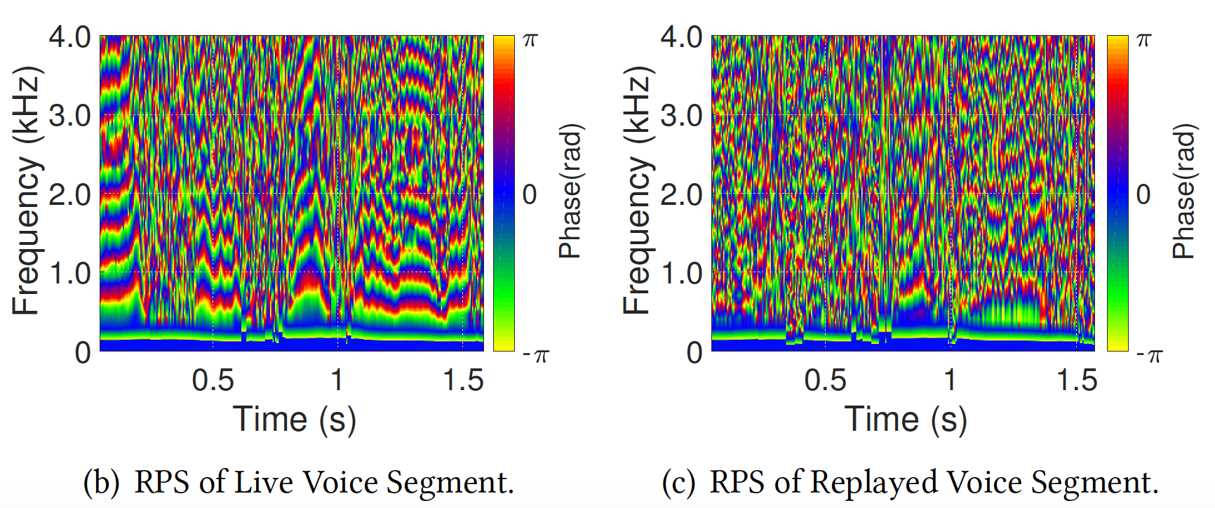
Different characteristics of live voice
More phase structure present in spectrogram

Slide 11
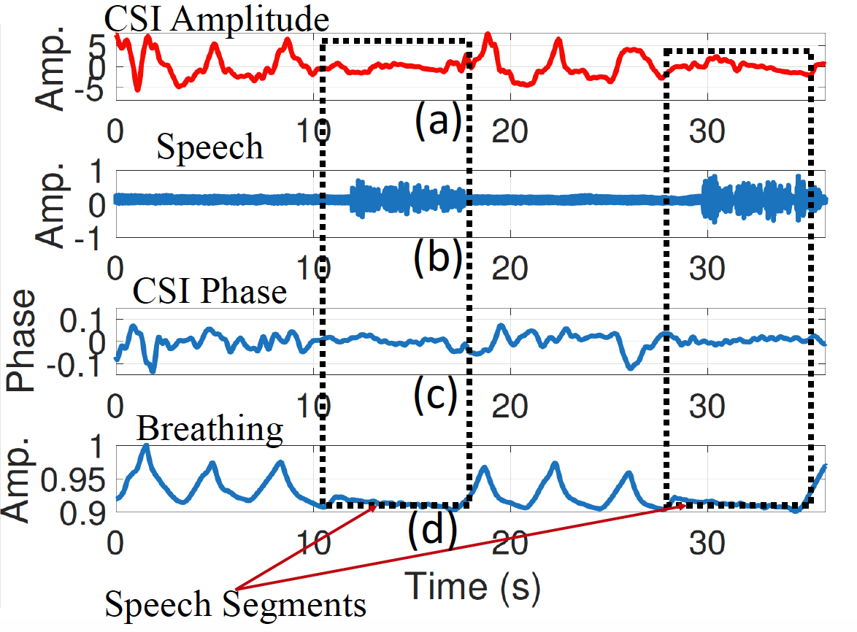
Breathing have distinct patterns
Breathing rate decreases during speech

Slide 12
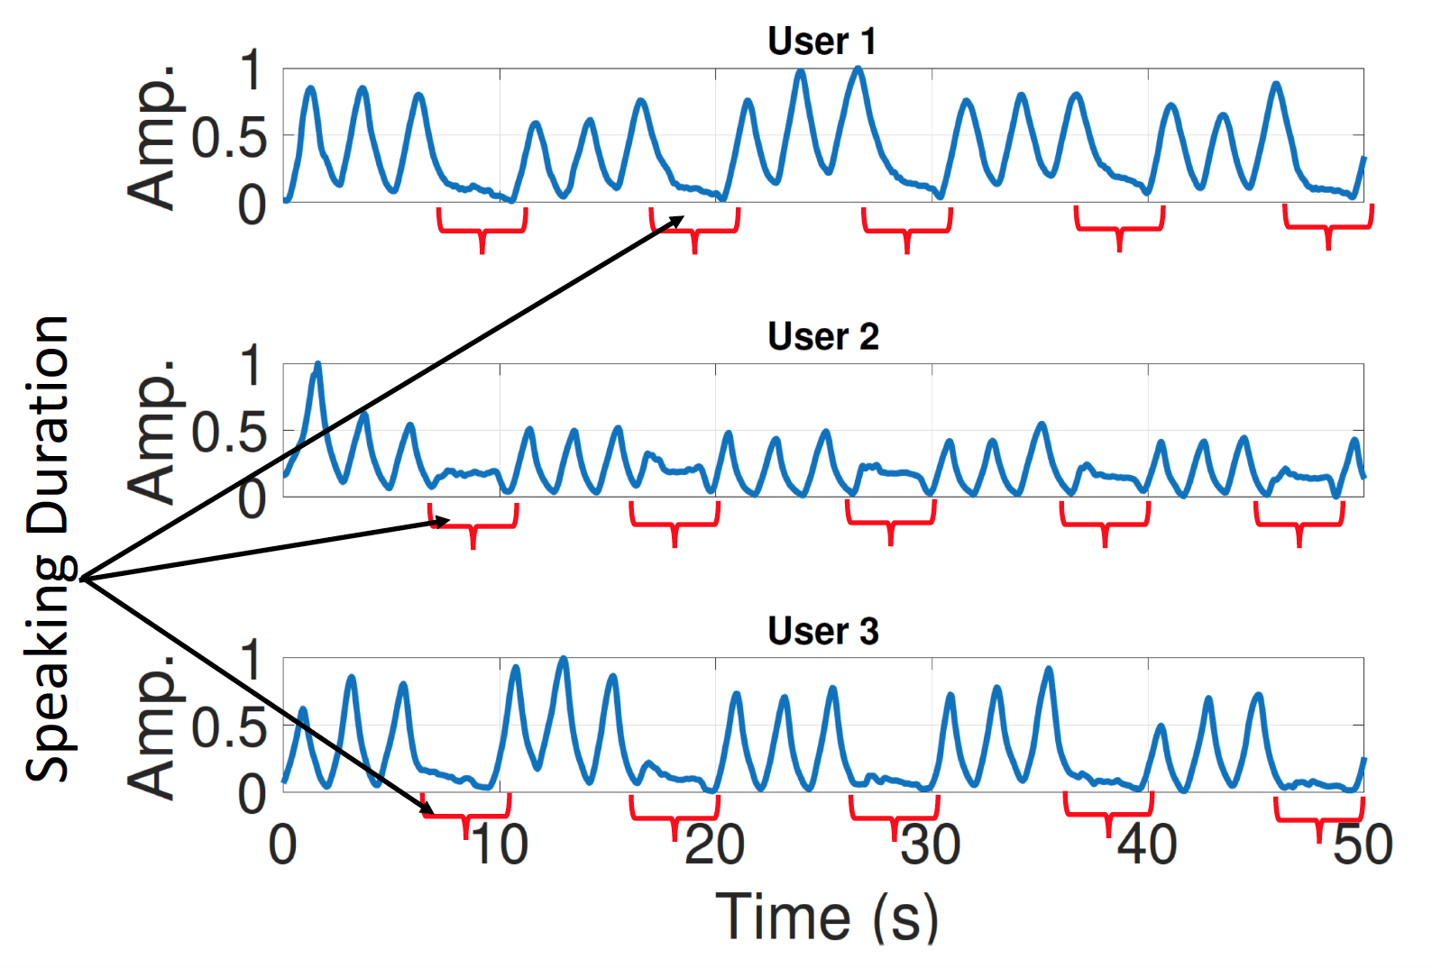
Breathing have distinct patterns
Different users have distinct breathing patterns

Slide 13
REplayed VOice Legitimacy Tester (REVOLT) workflow
Replayed
Human Absent
( Remote Replay )
( Physical Replay )
Speech based Replay Detection
WiFi based Breathing Detection
Breathing & Speech Synchronization
Human Absent
WiFi Spectrogram CNN based Manipulation Detection
( Physical Replay )
Manipulated
Genuine
Voice
( Sophisticated Physical
Replay )

Slide 14
Voice module of REVOLT
Replayed
( Remote Replay )
Speech based Replay Detection
MFCC, LFCC, RPS
Voice Feature Extraction
Voice Liveness Detection
SVM
MFCC: Mel Frequency Cepstral Coefficients
LFCC: Linear Frequency Cepstral Coefficients
RPS: Relative Phase Shift b/w two harmonics

Slide 15
WiFi based breathing detection
Human Absent
( Physical Replay )
WiFi based Breathing Detection
CSI Traces across subcarriers
FFT
(phase and amp.)
Breathing rate
Noise removal
Peak detect

Slide 16

Breathing-Speaking synchronization
Breathing & Speech Synchronization
Breathing and speaking traces
Breathing rates during and between speech
Synch. Score >
$$∆$$
Segmentation
Human Absent
Thresholding
& matching
( Physical Replay )

Slide 17
CNN based Manipulation Detection
Recorded WiFi Spectrogram during Speaking
Voice Manipulation Detector
Train CNN Model
WiFi Spectrogram CNN based Manipulation Detection
Convolutional Neural Net (CNN):
3 conv. layers -> Max-pool -> 2 FC layers
Manipulated
Genuine
Voice
( Sophisticated Physical
Replay )

Slide 18
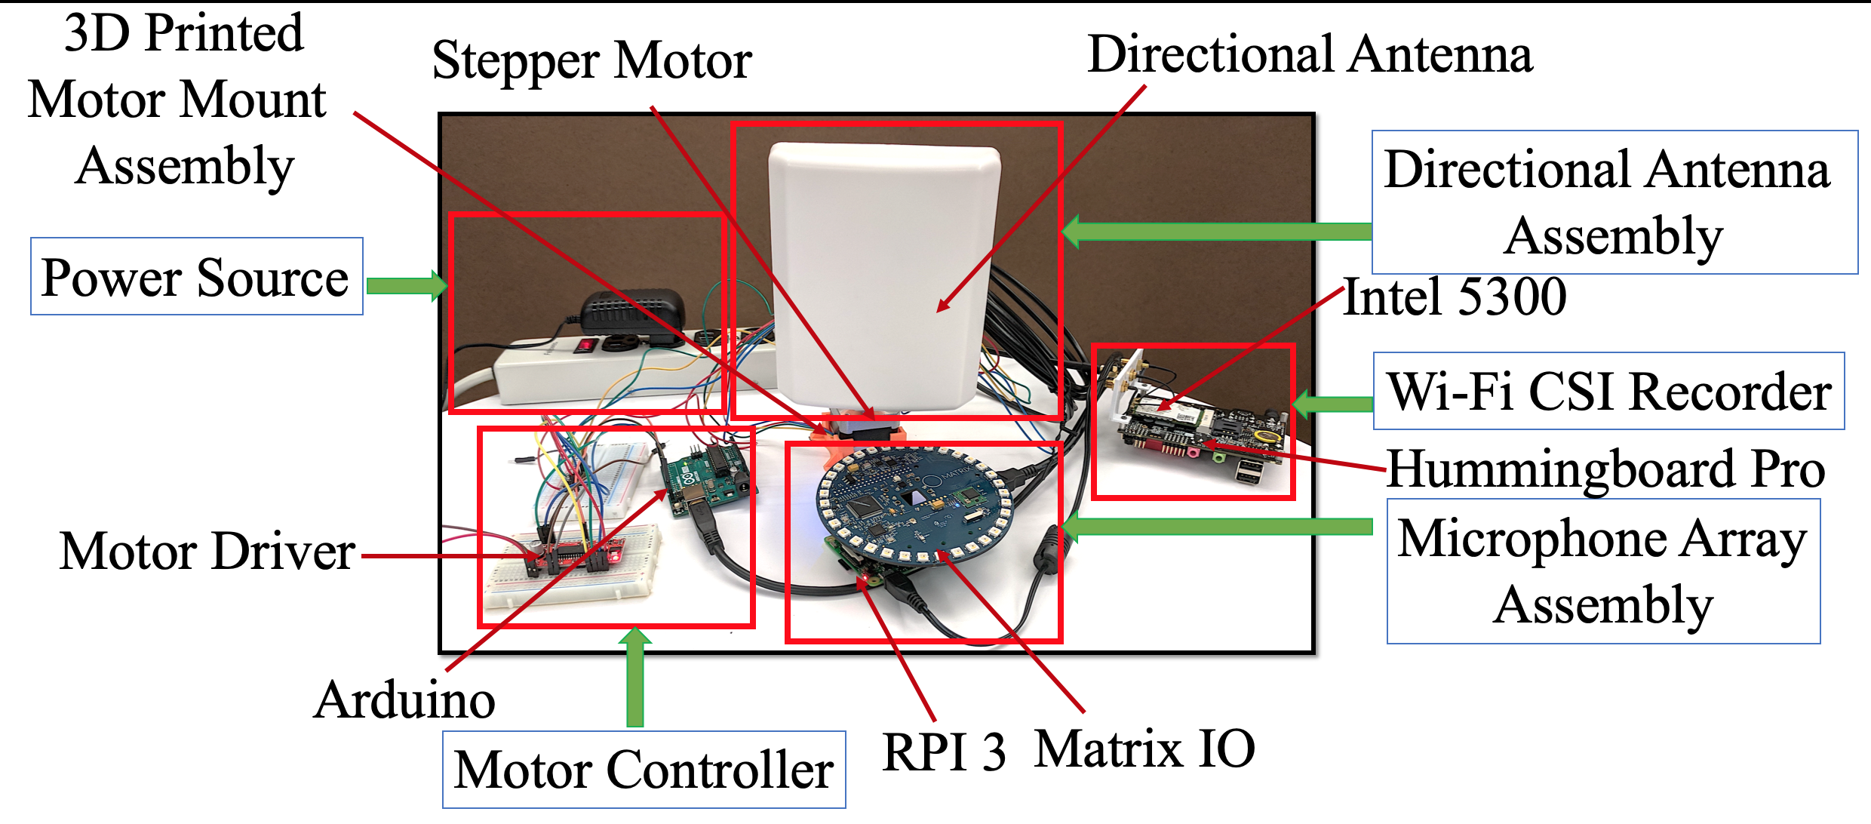
REVOLT prototype

Slide 19
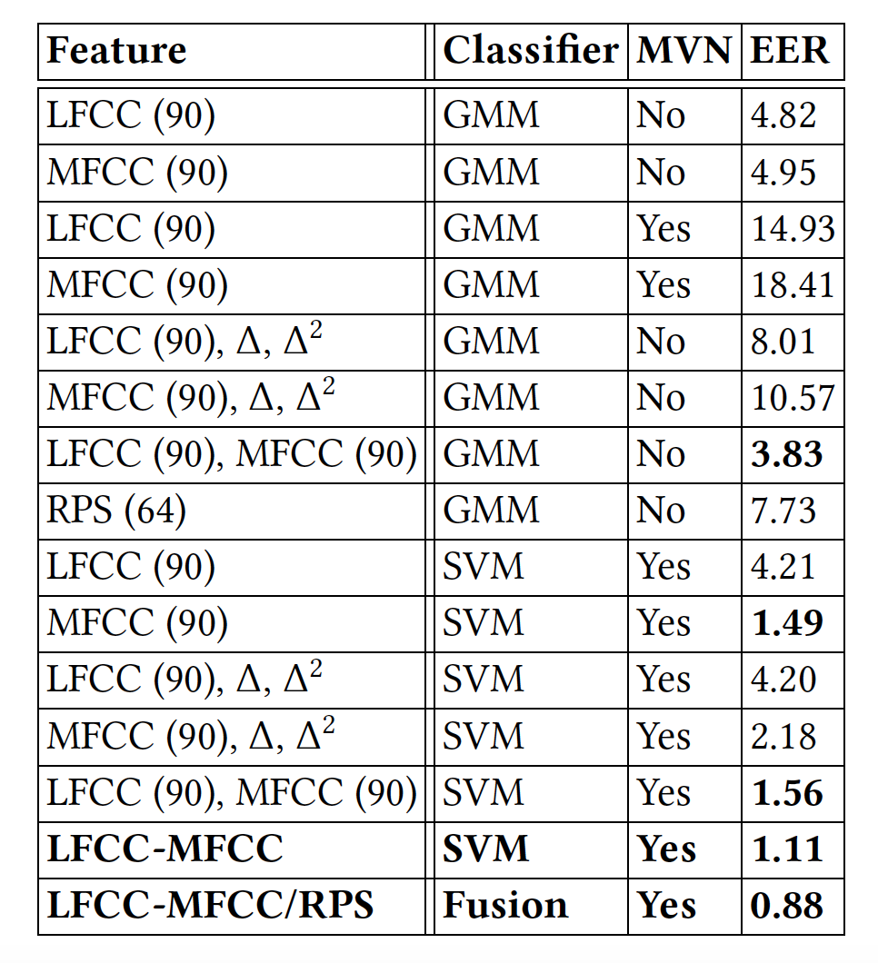
Voice module evaluation
Collected (~200 speaker, mic, location, user config.)
Both frequency and phase structure help
In voice only replay detection

Slide 20
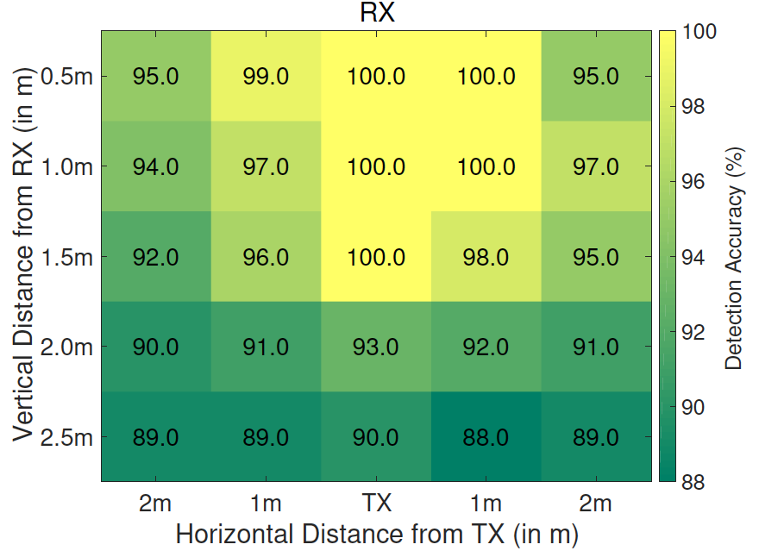
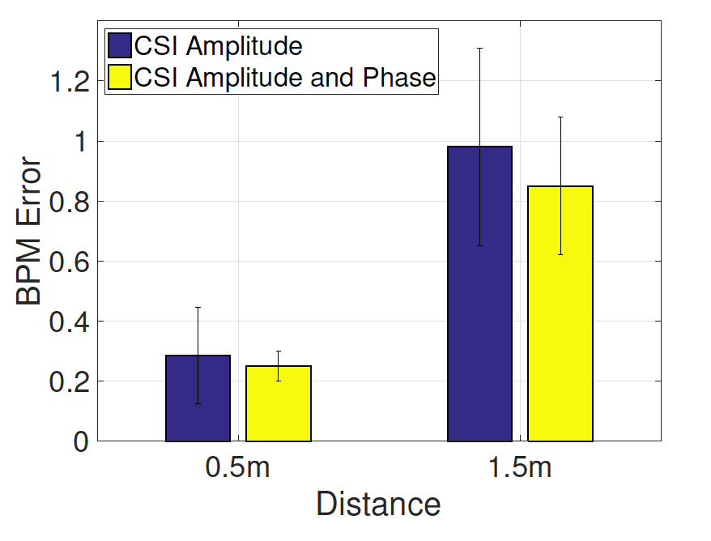
WiFi breathing detection evaluation
Exploiting both CSI phase and amplitude
helps in breathing detection

Slide 21
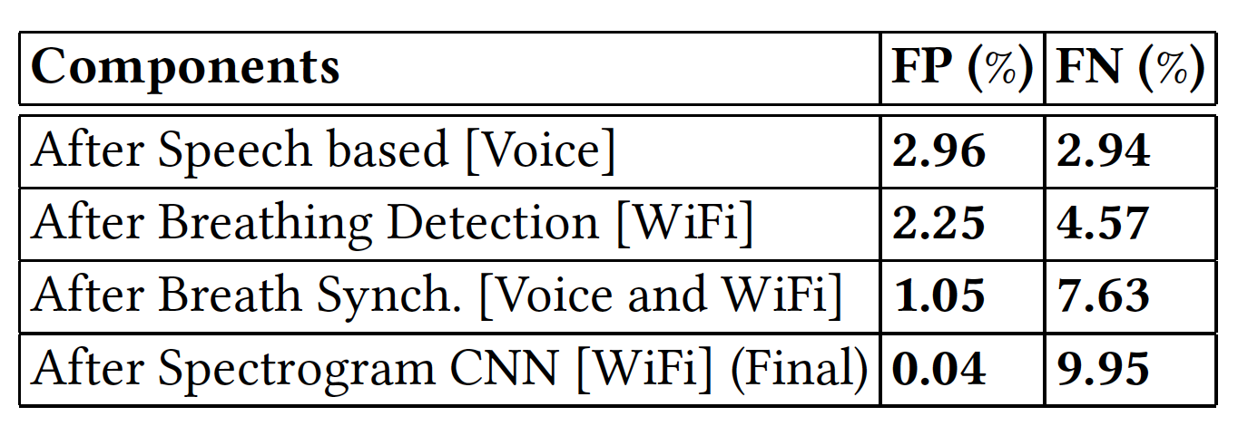
End-to-end model evaluation
Very low false-positive rate ensuring
almost replay prevention

Slide 22
Related works
Voice liveness detection
Ultrasonic based lip movement (Lu et al., Infocom ’18; Tan et al., IMWUT ‘18)
WiFi based lip utterance detection (Wei et al., MobiCom ‘15)
Voice localization (Zhang et al., CCS ‘16) …
Wearable based approach (Feng et al., MobiCom ‘17)
Speaker detection via magnetometer (Chen et al., ICDCS ‘17)
Needs extra hardware / small range (~10 cm) / extensive finger-printing

Slide 23
Future works
Adding state-of-the-art COTS Wi-Fi setup based respiration sensing ( up to 8 m, IMWUT 2019 )
Incorporating other wirelessly sensed soft biometrics
Heart rate, mouth movement pattern etc.
Moving from mechanical directional antenna
to phased array
Experimenting with more users and more diverse environments to evaluate the robustness

Slide 24
Key takeaways
Proposing a wearable-free long range voice replay detection system
Combining both wireless interfaces (Audio & WiFi) present in smart speakers for combating replay
Exploiting distinctiveness of breathing while speech for enhancing the security of voice assistants

Slide 25
Thanks a lot !
swadhin@utexas.edu
Notes:
Thanks a lot for you attention. For questions and queries please mail the author Swadhin Pradhan at swadhin@utexas.edu

